Slide 1
E-searching the Cultural heritage of Reading (18th-21st C.)
JPI meeting, Digital Technology and Heritage, issues & questions, March 12, 2021
Brigitte Ouvry-Vial Le Mans Université – Institut Universitaire de France

Slide 2
READ-IT Main Research Questions/Goals
A transnational & interdisciplinary research program building a large-scale online user interface to collect and analyse evidences of reading experiences.
Explore the vast trove of multimedia and multilingual testimonies and reports of reading experiences.
Enable future scholars to answer pending questions about Why and How people read in Europe in the past and today
Funding based on purported development of an ingestion detection and annotation tool (as automatic as possible) leading to the identification of “main” aspects of reading experience Reader- Reading matter- General circumstances- global response.
End-users expected to leverage these developments on their own for further “manual” or computer assisted text mining of self selected and uploaded resources.

Slide 3
READ-IT Program History
The program relies on an interdisciplinary consortium of 5 tight-knit teams in 4 countries:
-Le Mans U., France (B. Ouvry-Vial, PL): SSH, DH = management, sources curation, annotation campaigns, ontology
-IRISA, CNRS, Rennes, France (G. Gravier co-PL): scientific advisor, work flow design, AI (image detection), NLP
-ICL-Czeck Academy of Sciences(M. Wögerbauer PI): SSH, use-cases,multilingual historical sources (5+ languages)
-Open U., London, Arts & Knowledge Media Institute + IN2, (S. Towheed, PI), Data model, Dissemination, APIs
-Utrecht U., Digital Lab (J. van kruif), Interface developement, tools implementation
Main research steps (2018-2021):
2018: website; SSH specifications; First steps towards a preliminary datamodel and interface
2019: Validation Datamodel ; annotation tool (skinny version); 1st guidelines; campaign design;
2020: Full Annotation functionalities; DM implementation and ontology planning + NLP on annotations campaigns ; interface revisions
2021: Ontology Implementation; smart APIs (chatbot, MyCollections, Digital Postcard PEA); Interface sustainability

Slide 4
Examples of sources
« I lie contentedly enough, and amuse myself with a book which Qasim, seeing me in pain, has brought me in his kindness. It is his most treasured possession, a life of the Prophet in big lettering on rough paper, brown-black on brown-white, with flowered borders and headlines with the name of Allah, the author's name in a lunette at the top of every page, and the number of the page in a little flowered frame of its own on the margin. It gives one pleasure to handle anything done, even by mechanical means, with so much loving care. The book itself is written guilelessly, and tells the legends of Muhammad... » 1900-1945 / Reader: Freya Stark
« 3 stars for a book that is overloaded with the tortured mind of a Vietnamese spy now in France. I decided to read this book because i had read and enjoyed 2 books previously by this author. The steam of consciousness writing, with an emphasis on the ideas of various philosophers is at times confusing and too much information. That, plus depictions of torture, detracted from the enjoyment of the book. On the plus side, there is some interesting commentary from the Vietnamese point of view on American society, French colonizers and present French society. » [Goodreads, 2021]

Slide 5
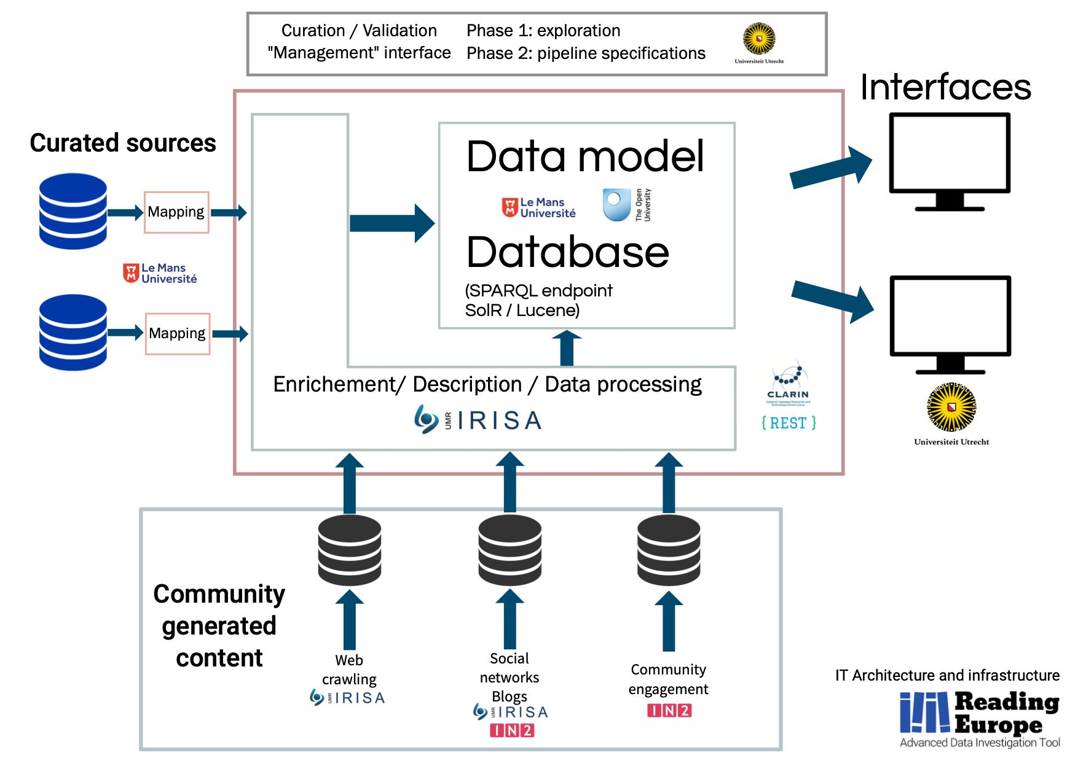
The ‘tool”: what we intended …
We will also hear from:
Annotation campaign
Historical sources

Slide 6
Where we stand …
Tools include :
(1) a conceptual model of reading experience capturing broad aspects, e.g., who reads what?, as well as close effects, e.g., readers response;
(2) the Reading Experience Ontology (REO), a module for the ISO standard CIDOC-CRM for cultural heritage;
(3) the annotation tool for text-based sources;
(4) the Crowdsource of Experience Ontology (CEO);
(5) a multimodal crowdsourcing platform for collecting reading testimonies (including during the pandemic), such as archives, postcards, chatbot conversations;
(6) machine-learning services for the pre-annotation of sources and images, all components supporting the five languages of the project.

Slide 7
Reading Experiences Ontology (Main Classes 1st & 2d levels: Reader/ Act of Reading/Ressource/Circumstances/ Output ...)

Slide 8
Reassessments…
Concepts and objectives : use cases raised issues about a more fine grained quantitative and qualitative analysis: targeted crawling of repositories +automatic search of relevant resources + focus on reading response (emotions, effects, thoughts, judgments). This is NOT the plan (despite obvious needs).
Unexpected side-projects or pop-ups through PEAs: Contribution Portal set-up: https://readit-project.eu/category/news crowdsourcing contribution portal ”Reading during the pandemic” ; chatbot in 3 languages [A. Antonini; M. Parma].
The interface has just been upgraded to version 0.9.0 (https://read-it.hum.uu.nl ):
Search queries and fields are now reflected in the route. This means you can share or save search results. E.g. https://read-it.hum.uu.nl/explore/sources?query=Babelio&fields=title;
Annotations now have dedicated routes, that also open the corresponding source and item panels. This allows navigating to an annotation and immediately seeing its context. E.g. https://read-it.hum.uu.nl/explore/source/225/annotations/100332
Pagination for search results, with 10 results per page, allowing quick navigation for large number of search results.
Multiple annotations for the same selected text are now supported. Select an existing annotation and click 'New' to add an annotation.
Dutch, Italian and Czech are now available as languages when uploading a source.
[UU Interface team: J. Gonggrijp, B. Janssen, J. van Boheemen]

Slide 9
Insights and Spin-offs projects
Novel explorations of massive and previously unknown accounts by ordinary readers [All members]
NLP Processing/predictions on supervised or unsupervised textual sources [G. Le Noe-Bienvenu]
Further focus on readers’ response : doctoral thesis (E. Prat, Le Mans U.) Emotions of French readers 1970-2015 Archives Nationales de France ; « Mapping the emotions of readers » Dr R. Klinger (Stuttgart U. ) & B. Ouvry-Vial (Le Mans U.) ; Young readers remindings (A. Kuzmikova, Prague); Transmedia interactions in digital-native formats, (F. Benatti, A. Antonini); thesaurus, collaborative annotation (F. Vignale), etc…
Annotation guidelines

Slide 10
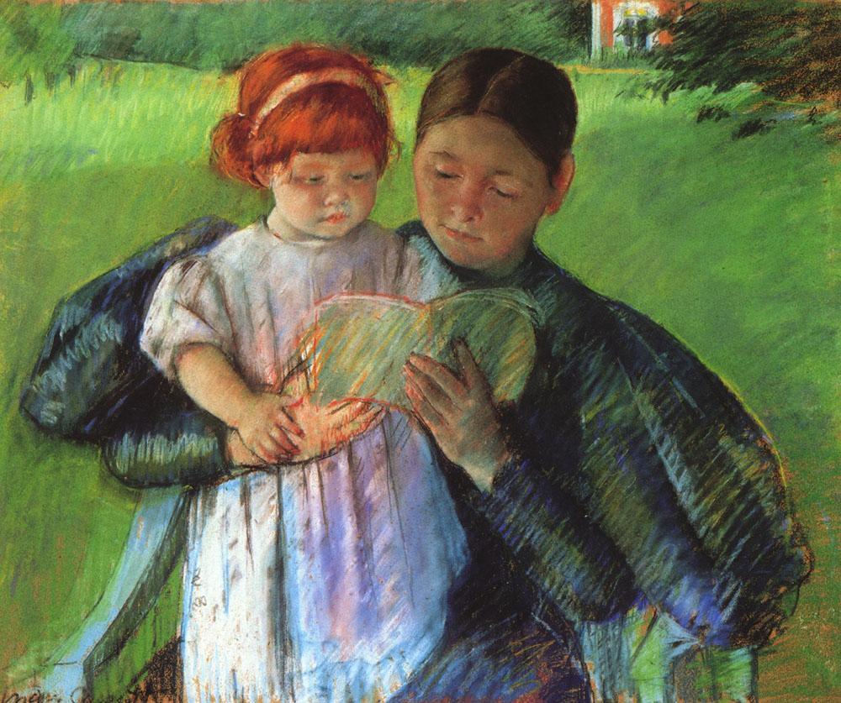
Automatical retrieval of concepts from images still off-limits…
Daylight
Painting
2 persons
Outside
Book
Garden
Seating
Source : Mary Cassatt, Nurse reading to a little girl, 1895, NY, Metropolitan Museum of Art

Slide 11
Thank you! www.readit-project.eu

